Slide 1
Data driven enhancement of real estate appraisal methods 24th ERES Congress Delft, 28 June – 1 July 2017
Wolfgang A. Brunauer*
Wolfgang Feilmayr**
Ronald S. Weberndorfer*
* DataScience Service GmbH
www.datascience-service.at
**Department of Spatial Planning
Vienna University of Technology

Slide 2
Content
The Sales Comparison Approach in Austria
Method
Data and model structure
Data driven derivation of comparables
Statistical quality adjustment
Consideration of distance
Spatial Weight Matrix & Parameter
Simulation
Further Improvement: Transaction discounts

Slide 3
The Sales Comparison Approach in Austria
LBG und ÖNORM B 1802:
Wertermittlung durch Vergleich mit Preisen vergleichbarer Immobilien
Berücksichtigung abweichender Eigenschaften bzw. geänderter Marktverhältnisse
Voraussetzung:
Ausreichende Anzahl von Vergleichspreisen
Ausschluss von nicht repräsentativen Preisen (Liebhaberpreise, Transaktionen unter Freunden/Verwandten oder innerhalb von Konzernen etc.)
Vergleichspreise idealerweise nicht älter als vier Jaher (Kranewitter)
Direkter Preisvergleich meist nicht möglich Zu- oder Abschläge für…
Lage (räumliche Preisvariation)
Marktschwankungen (zeitliche Preisentwicklung)
Ausstattungsmerkmale (Qualitätsunterschiede)
Rechte und Lasten

Slide 4
Method
Real estate consist of a wide range of characteristics that make each object unique: differentiated goods, which are valued for their utility-bearing characteristics
Implicit choice of many different goods and services: If a household buys an object, it selects a set of values for each of the K (structural and locational) characteristics z = (z1, z2, . . . , zK)
Therefore, the price of the house or apartment is a function of the whole bundle of characteristics, or P = P(z), with functional relationships possibly varying over time and space: the hedonic price function

Slide 5
Method
The hedonic price function is a joint envelope function of all individual optimal bid and offer functions.
Thus, there is an explicit price for the whole bundle of characteristics, and an implicit price for each single characteristic.
Implicit prices can be determined e.g. in a multiple regression model.
We expect to observe decreasing relationships between the market price and its measured attributes, although literature does not give clear guidance concerning functional specifications. Usually specified in a log- or semi-log form:
“Multiplicative“ model structure
Reduction of heteroscedasticity
Coefficients can be interpreted as (semi-)elasticities

Slide 6
Method
Basic Approach:
Residential properties belong to several levels of spatial (administrative) units.
Data describing the neighborhood or location is accounted for on the most granular level available, in a possibly nonlinear functional form.
Furthermore, it is reasonable to assume that local policy, infrastructure and other unmeasured locational characteristics affect individual house prices (unobserved spatial heterogeneity), which turns the hedonic pricing model into a multilevel or hierarchical regression problem.
Challenges in hedonic price modeling:
Nonlinearity
Spatial heterogeneity
Spatial autocorrelation

Slide 7
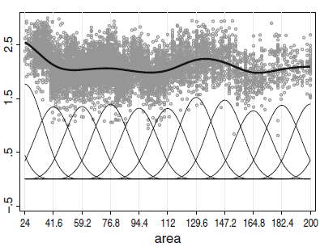
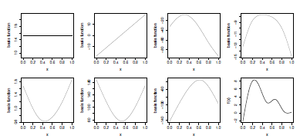
Method
We use Generalized Additive Models (GAM; Wood, 2006)
Distributional and structural assumptions, given covariates and parameters, are based on Generalized Linear Models.
with additive predictor
is parametric part of the predictor
is a continuous covariate, time scale, location or unit- or cluster index
one-/two (even three) dimensional, not necessarily continuous functions
Continuous covariate effects are modeled using penalized regression splines:
P-Splines, which model nonlinear relationships using truncated polynomials (usually of order 3) with additional penalization terms.
Thin plate regression splines, i.e. low rank smoothers base on truncated Eigen-decomposition
Spatial indices on two hierarchical levels are modeled using random effects (penalized by a ridge penalty)
Automated selection of the smoothing parameter using the Generalized Cross Validation (GCV) criterion.
Source: Wood (2006)
Census tract
Municipality
„Location Value“
District
Spatial ordering

Slide 8
Data and model structure
Data from JUSTIMMO: 1.1.2013 – 25.7.2016
17.000 single family homes
42.000 apartments
Location data: Point, census tract
Noise
Accessibility: driving time to city center, distance to subway station
Education
Area, age, condition, etc.
Noise, accessibility, education etc.
Municipality random effect
District random effect
State fixed effect

Slide 9
Data and model structure

Slide 10
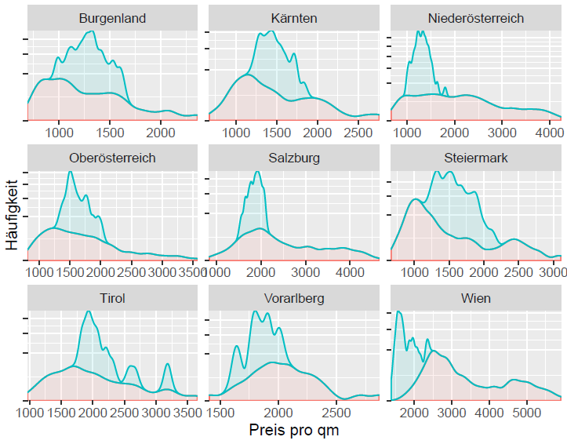
Statistical quality adjustment
Location effects
Observed spatial heterogeneity (Location variable effect)
Unobserved spatial heterogeneity (Hierarchical Cluster effect)
Single Family home: Apartment:

Slide 11
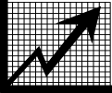
Statistical quality adjustment
Example: Apartment in Salzburg
?
 |  | Comparable | Correction factor | Valuation
 | Address | Alpenstraße 8 , 5020 Salzburg | 1,1 % | Alpenstraße 20, 5020 Salzburg
 | Construction | 2016 | - 26,0 % | 1990
 | Area | 57 m² | - 3,1 % | 80 m²
 | Trend | Februar 2016 | + 3,8 % | Juli 2016
 | Misc. | EG, Garten, kein Stellplatz, Zentralheizung | + 4,4 % | 2. OG mit Aufzug, Stellplatz, Balkon, Zentralheizung, Parkett
 | Comparison price: | 6200 Euro / m² | Quality adjusted: | 4800 Euro / m²

Slide 12
Statistical quality adjustment
Variable effects for example:
Location: - 1,1 %
Age: - 26 %
Area: -3,1 %
Trend: +3,8 %
35
55
90
150
240
2013-04 2013-10 2014-05 2014-11 2015-06 2016-01 2016-07

Slide 13
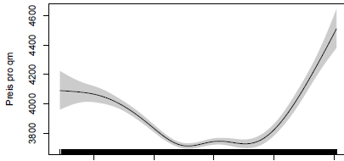
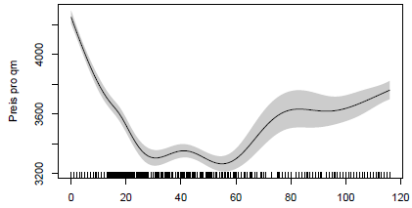
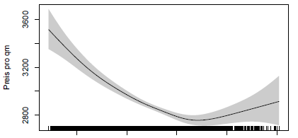
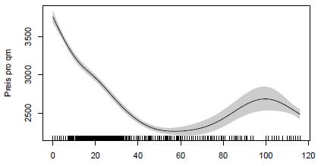
Statistical quality adjustment
Variable effects flats: Vienna vs. other cities
 | Area | Age
Vienna
Other cities
35
55
90
150
240
35
55
90
150
240

Slide 14
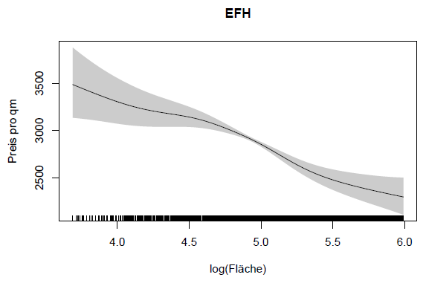
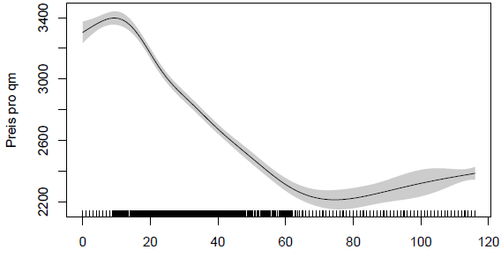
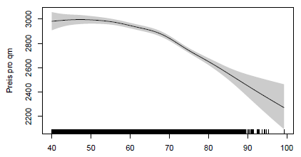
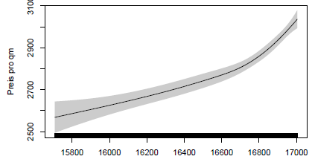
Statistical quality adjustment
Variable effects family homes:
Area
Age
55
90
150
240
400
Noise
Trend
Trend
2013-04 2013-10 2014-05 2014-11 2015-06 2016-01 2016-07

Slide 15
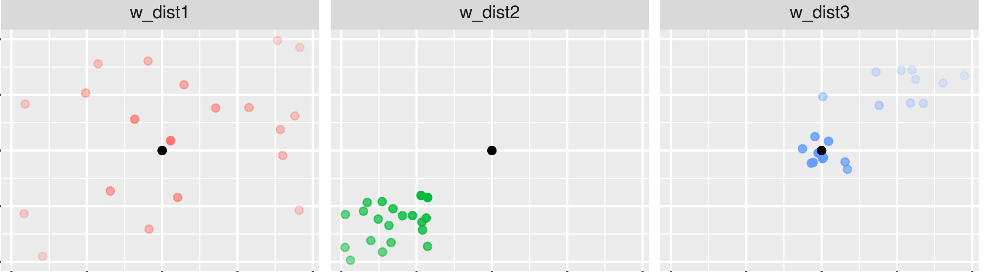
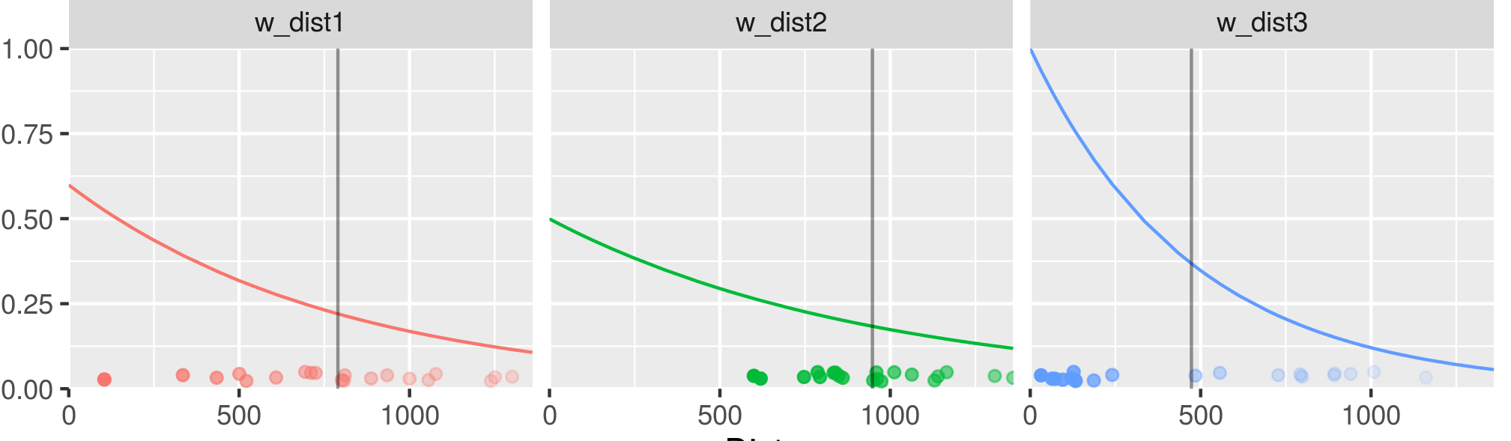
Consideration of distance
Adaptive exponential distance weights
 | Uniform distribution Wide range | Uniform distribution Small range | Two gaussian clusters
Distribution

Slide 16
Spatial Weight Matrix & Parameter
Treatment of comparables similar to a spatial error model:
Define neighborhood structure / spatial decay in neighborhood matrix W
Spatial correlation parameter ρset to 1
Open questions:
Weight matrix
Distance vs. equal weight?
How many comparables?
Spatial error parameter?

Slide 17
Spatial Weight Matrix & Parameter
Calculate error in 5fold cross validation
80% training
20% test (non-overlapping)
Variation:
number of neighbors (5-50) and
spatial autocorrelation parameter (0-1 by 0.01)
Distance vs. equal weight
Calculate median absolute error for each test sample
Average over errors for all test samples
Determine minimum error over all grid cells

Slide 18
Spatial Weight Matrix & Parameter
Flat / Vienna – equal weight
Reduction of prediction error
Hedonic vs. ρ=1, NN=9 | 6.58%
Hedonic vs ρ=0.74, NN=7 | 7.24%

Slide 19
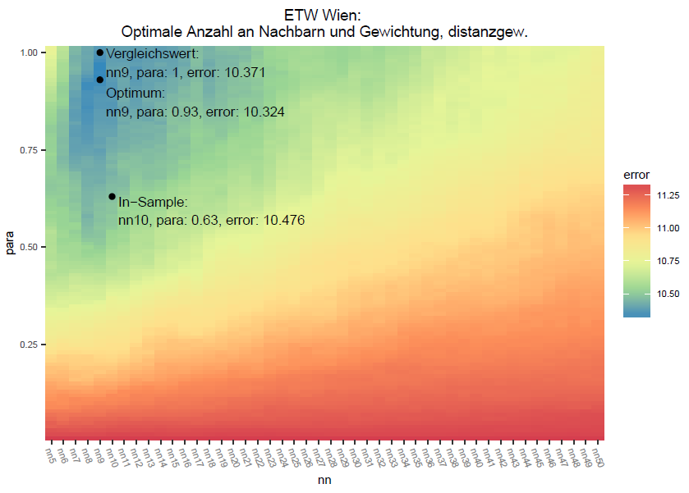
Spatial Weight Matrix & Parameter
Flat / Vienna – distance weight
Reduction of prediction error
Hedonic vs. ρ=1, NN=9 | 9.41%
Hedonic vs ρ=0.93, NN=9 | 9.91%

Slide 20
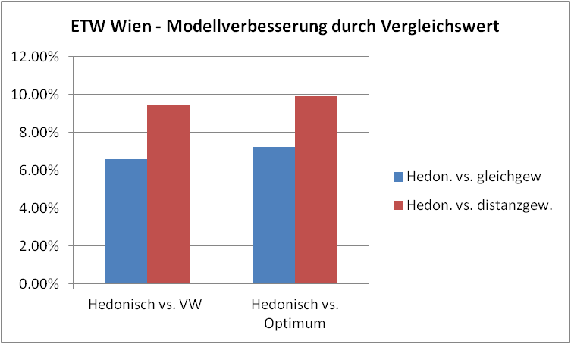
Spatial Weight Matrix & Parameter
Flat / Vienna – wrap up
Improvement in predictive error from unadjusted best comparison method to hedonic model: 64%
Further improvement using optimal number of comparables 10% (distance weight)

Slide 21
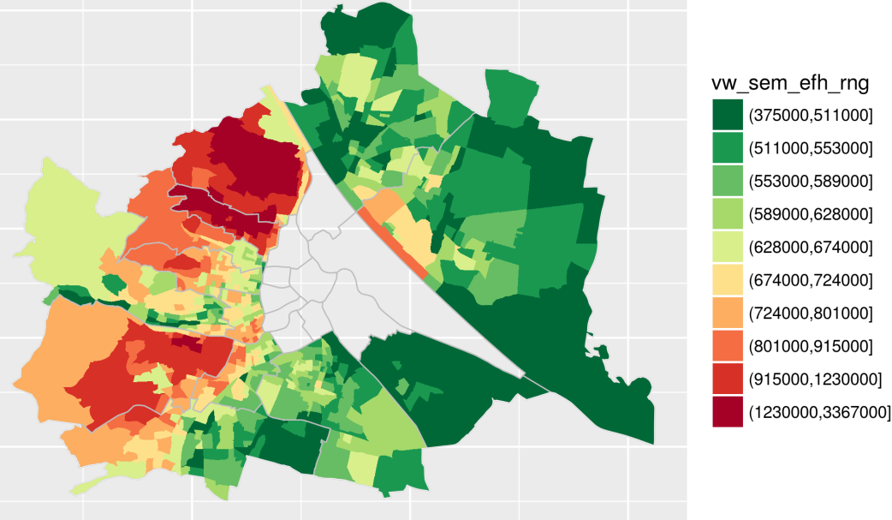
Simulation Single Family Homes
Simulation
Living area: 120m²
Plot area: 650 m²
Construction year: 2000

Slide 22
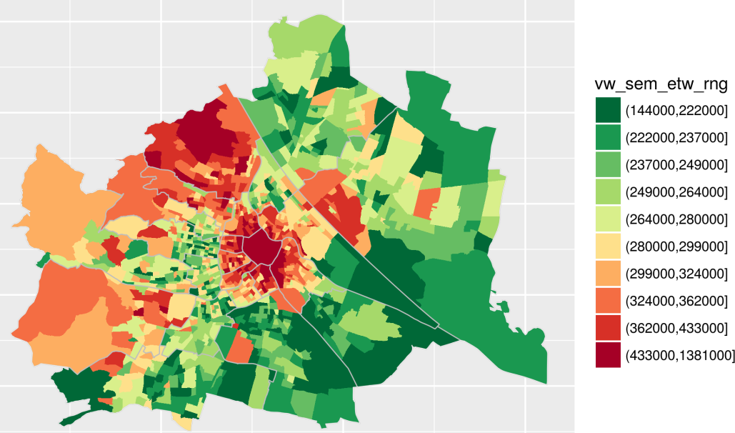
Simulation Apartments
Simulation
Living area: 80m²
Construction year: 2000
Floor: 2. OG, elevator

Slide 23
Further Improvement : Transaction discounts
The comparison method should only be used for purchase price data
However, the Austrian land register hardly provides any quality information
Therefore, we try to match purchase prices* to offer prices
3.700 apartments
2.400 family homes
Calculation of „transaction discount“ from offer to purchase price data
* purchase price data was provided by ZT Datenforum for academic purposes

Slide 24
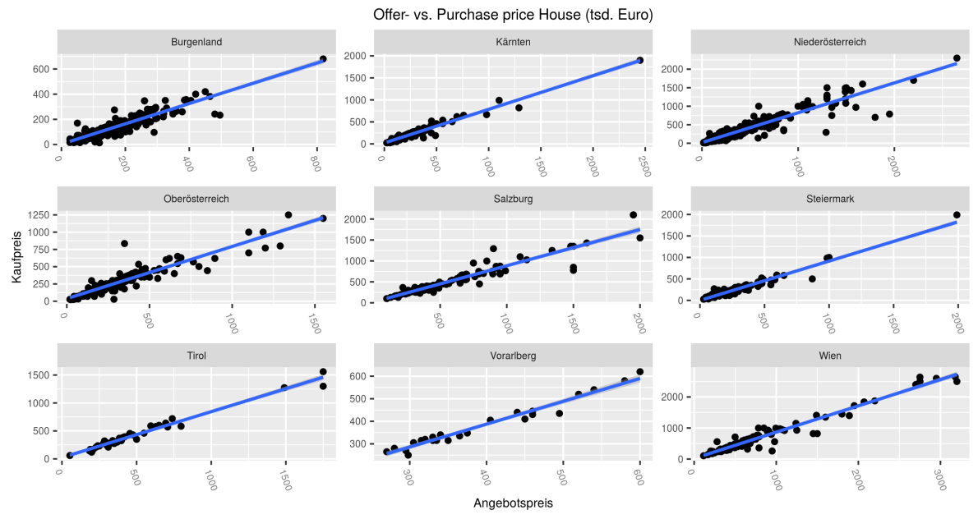
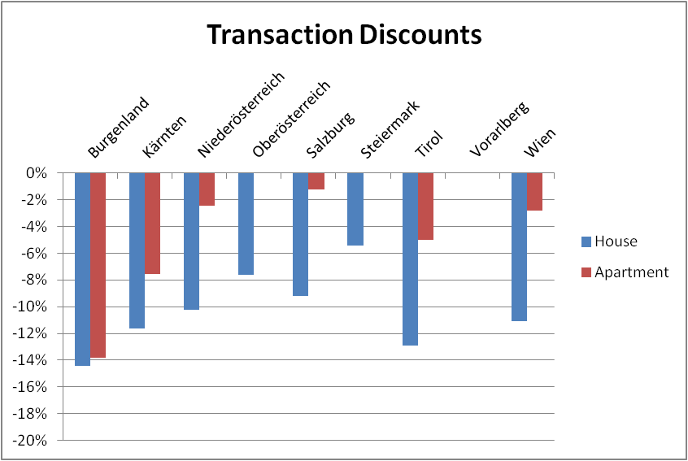
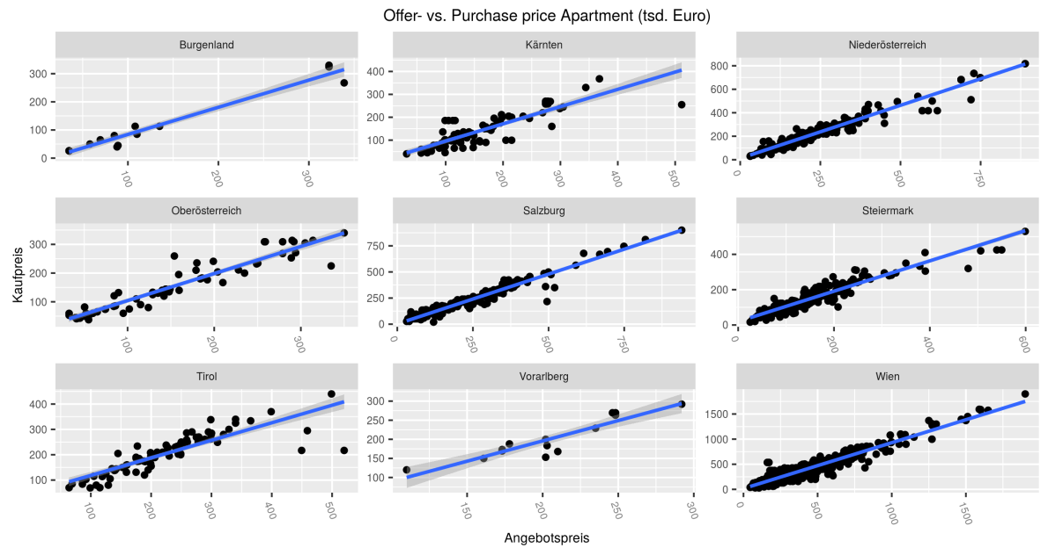
Further Improvement : Transaction discounts
Transaction discounts over states for
family homes upper panel)
Apartments (lower panel)

Slide 25
DataScience Service GmbH
Erzherzog Johann Platz 1
1. Stock (i²c Founder Space) 1040 Wien
www.datascience-service.at
DI(FH) Mag. Dr. Wolfgang A. Brunauer
+43 664 / 16 234 66 wb@ds-s.at
DI Dr. Ronald S. Weberndorfer
+43 650 / 47 000 70 rw@ds-s.at

Slide 26
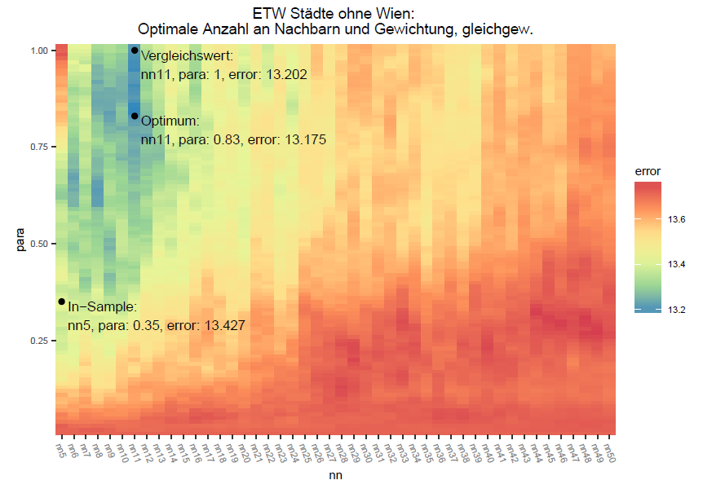
Ableitung der optimalen Anzahl an Vergleichsobjekten
Wohnung / Städte ohne Wien - gleichgewichtet
Verbesserung durch Vergleichswert
Hedonisch vs. VW | 3.97%
Hedonisch vs. Optimum | 4.18%
VW vs. Optimum | 0.20%

Slide 27
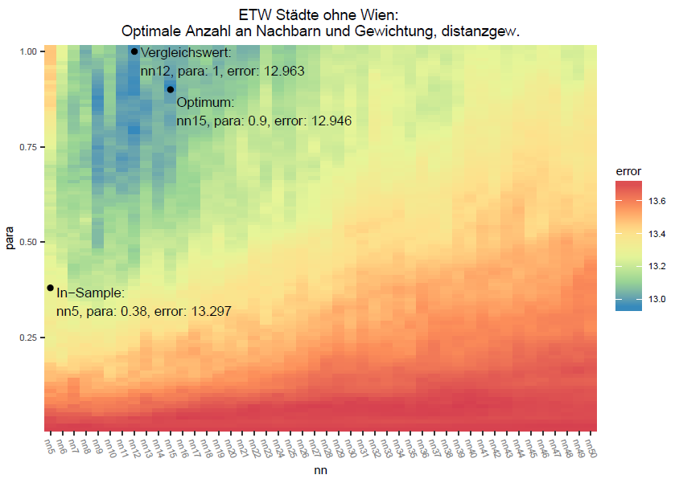
Ableitung der optimalen Anzahl an Vergleichsobjekten
Wohnung / Städte ohne Wien - distanzgewichtet
Verbesserung durch Vergleichswert
Hedonisch vs. VW | 5.89%
Hedonisch vs. Optimum | 6.03%
VW vs. Optimum | 0.13%

Slide 28
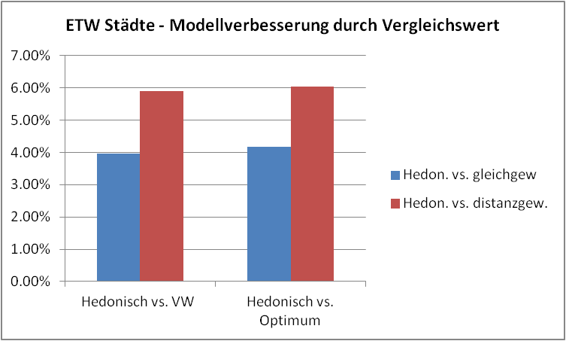
Ableitung der optimalen Anzahl an Vergleichsobjekten
Wohnung / Städte ohne Wien – Zusammenfassung
Das statistische Modell ohne Vergleichswert ist ca. 55% besser als der beste unbereinigte Vergleichswert
Die Prognosegenauigkeit durch das Vergleichswertverfahren erhöht sich um bis zu 6%

Slide 29
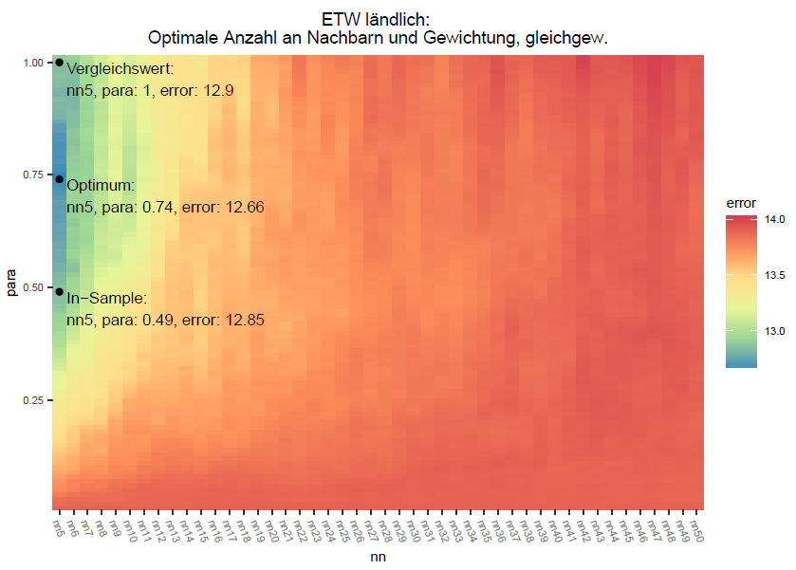
Ableitung der optimalen Anzahl an Vergleichsobjekten
Wohnung / Restösterreich - gleichgewichtet
Verbesserung durch Vergleichswert
Hedonisch vs. VW | 7.71%
Hedonisch vs. Optimum | 9.76%
VW vs. Optimum | 1.90%

Slide 30
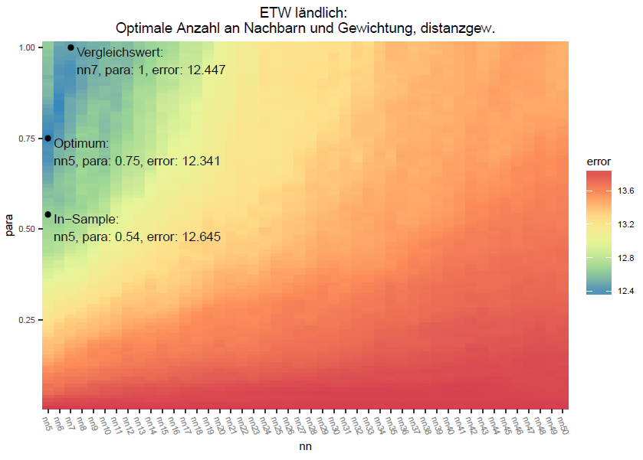
Ableitung der optimalen Anzahl an Vergleichsobjekten
Wohnung / Restösterreich - distanzgewichtet
Verbesserung durch Vergleichswert
Hedonisch vs. VW | 11.63%
Hedonisch vs. Optimum | 12.59%
VW vs. Optimum | 0.86%

Slide 31
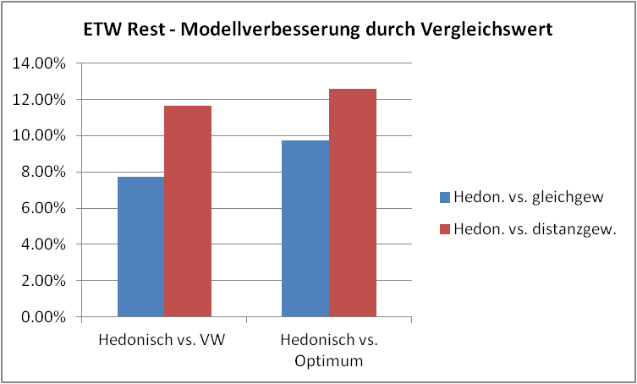
Ableitung der optimalen Anzahl an Vergleichsobjekten
Wohnung / Restösterreich – Zusammenfassung
Das statistische Modell ohne Vergleichswert ist ca. 45% besser als der beste unbereinigte Vergleichswert
Die Prognosegenauigkeit durch das Vergleichswertverfahren erhöht sich um bis zu 13%

Slide 32
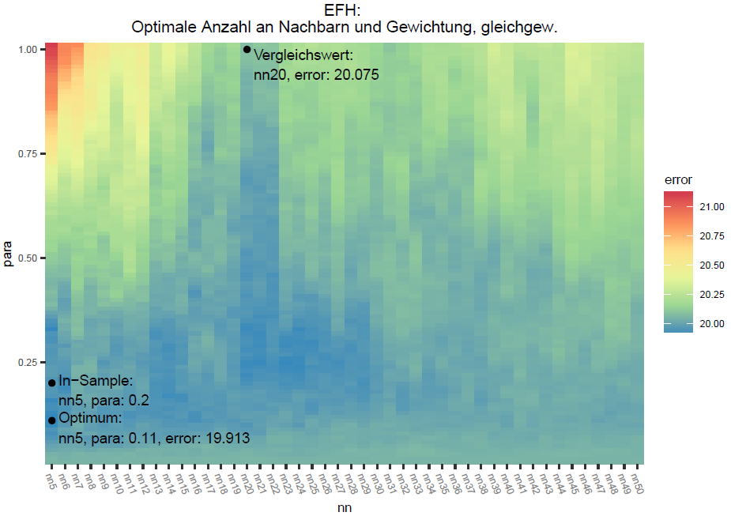
Ableitung der optimalen Anzahl an Vergleichsobjekten
Haus - gleichgewichtet
Verbesserung durch Vergleichswert
Hedonisch vs. VW | -0.11%
Hedonisch vs. Optimum | 0.7%
VW vs. Optimum | 0.81%

Slide 33
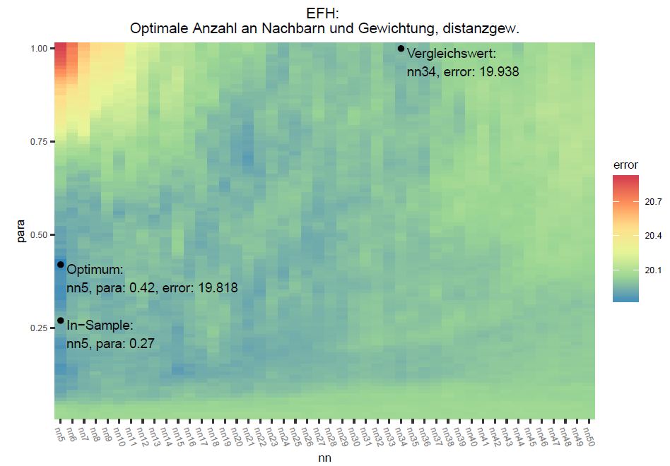
Ableitung der optimalen Anzahl an Vergleichsobjekten
Haus - distanzgewichtet
Verbesserung durch Vergleichswert
Hedonisch vs. VW | 0.58%
Hedonisch vs. Optimum | 1.19%
VW vs. Optimum | 0.61%

Slide 34
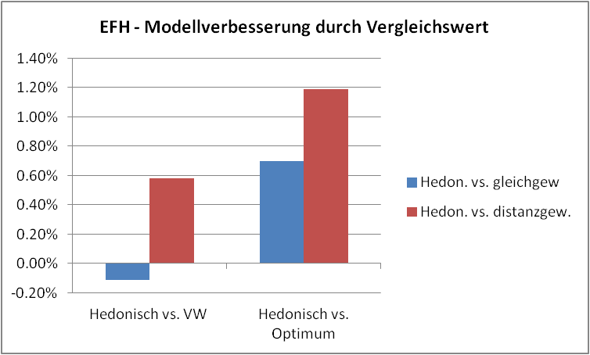
Ableitung der optimalen Anzahl an Vergleichsobjekten
Haus – Zusammenfassung
Das statistische Modell ohne Vergleichswert ist ca. 58% besser als der beste unbereinigte Vergleichswert
Die Prognosegenauigkeit durch das Vergleichswertverfahren erhöht sich um bis zu 1%, bei Haus also keine signifikante Verbesserung

